Slide 1
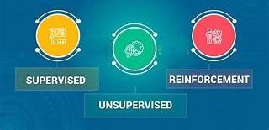

Slide 2
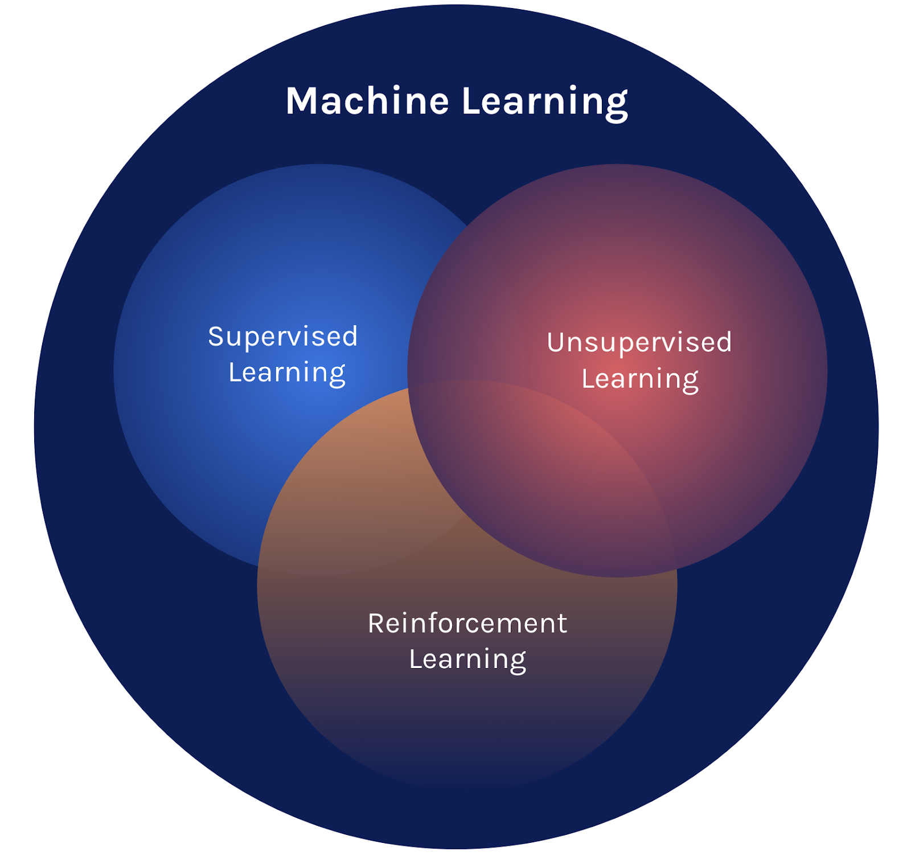
Basically this is the part of Machine learning we have these points into the chapter called “ Learning and Planning”
In that we have 3 types
There are 3 types
Spervised Learning:
Contains labeled data.
Unsupervised Learning:
Contains Unlabeled data
Reinforcement Learning:
It learns from feedback based on their actions
FET -1
TY CSE B
Subject: Intelligent System
Team Members:
1. Ranveer Ghorpade(04)
2. Pratiksha Patil(19)
Guided by
Mrs. Ambika Gadkari

Slide 3
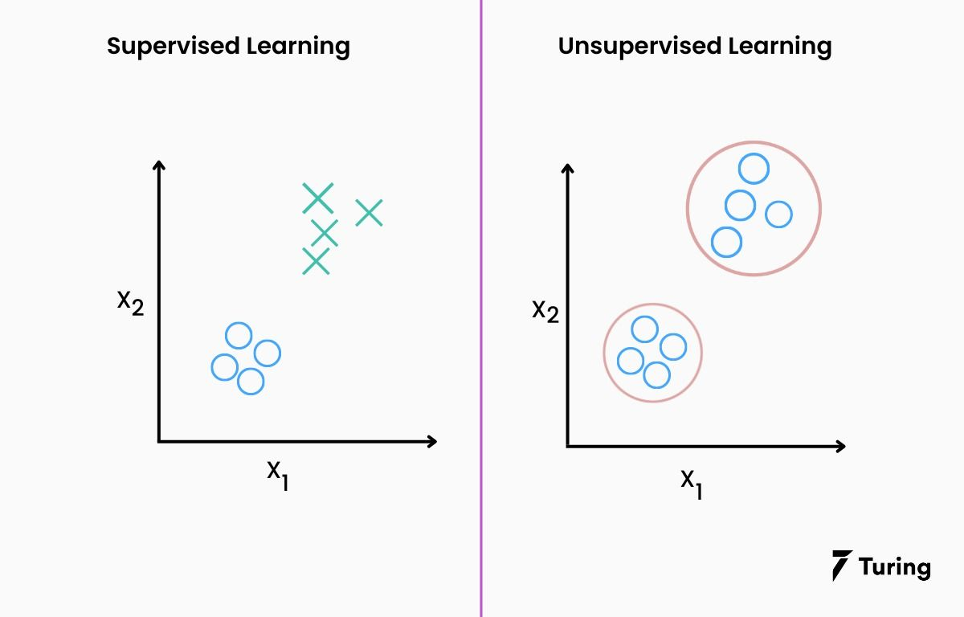
Basically this is the part of Machine learning we have these points into the chapter called “ Learning and Planning”
In that we have 3 types
There are
Spervised Learning:
Contains labeled data.
Unsupervised Learning:
Contains Unlabeled data
Reinforcement Learning:
It learns from feedback based on their actions
Supervised Learning
Supervised Learning as the name indicates has the presence of a supervisor as a teacher
Supervised learning is when we teach or train the machine using data that is well-labelled.
To understand the concept:
For instance, suppose you are given a basket filled with different kinds of fruits. Now the first step is to train the machine with all the different fruits.
Ex: identify the fruits based on their features

Slide 4
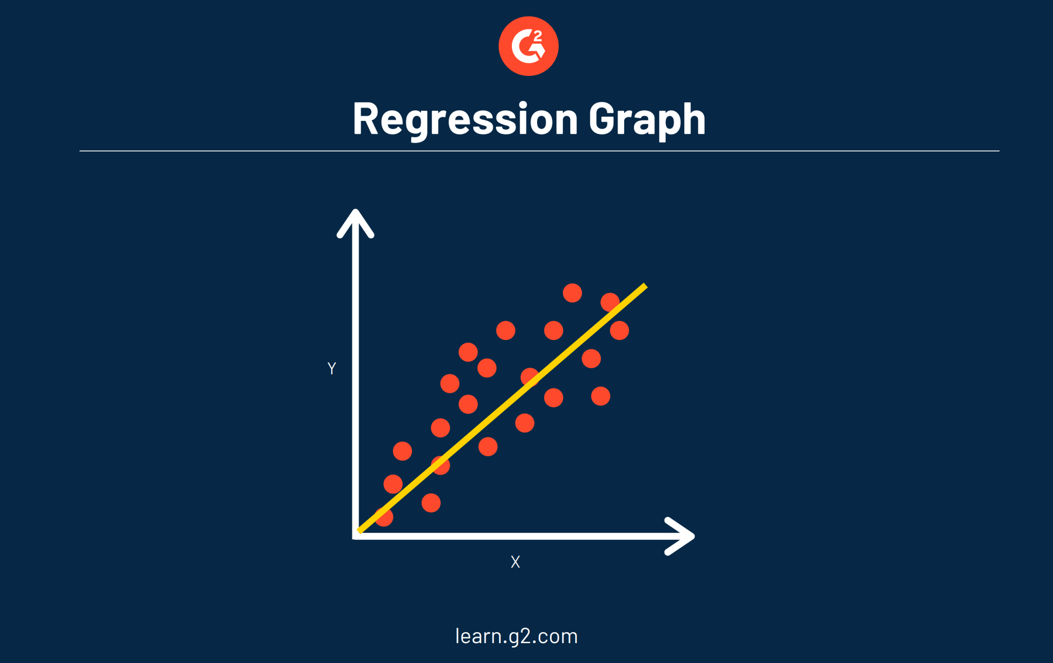
Supervised Learning
Supervised Learning as the name indicates has the presence of a supervisor as a teacher
Supervised learning is when we teach or train the machine using data that is well-labelled.
To understand the concept:
For instance, suppose you are given a basket filled with different kinds of fruits. Now the first step is to train the machine with all the different fruits.
Ex: identify the fruits based on their features
Types of Supervised Learning
Regression
Purpose: Predicts continuous numerical values.
Output: Real-valued numbers (e.g., price, temperature, salary).
Examples:
Predicting house prices based on features like size, location, etc.
Forecasting stock prices over time.
Common Algorithms:
Linear Regression
Polynomial Regression
Decision Trees (for regression)
Support Vector Regression (SVR)

Slide 5
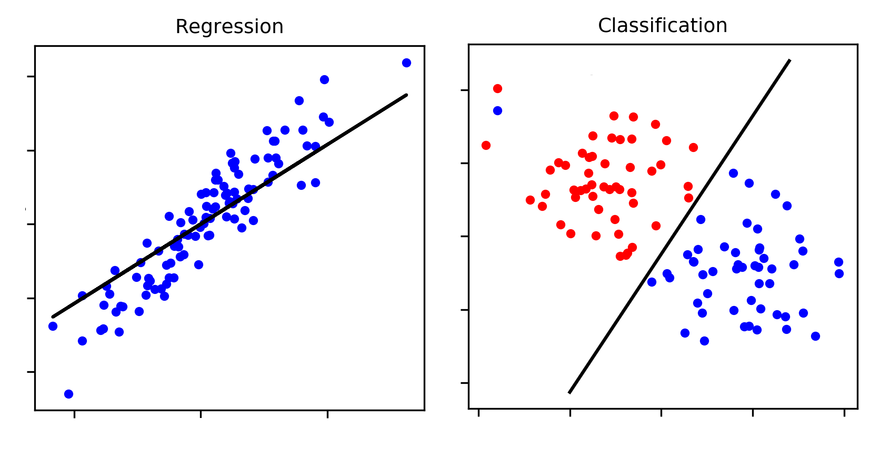
Types of Supervised Learning
Regression
Purpose: Predicts continuous numerical values.
Output: Real-valued numbers (e.g., price, temperature, salary).
Examples:
Predicting house prices based on features like size, location, etc.
Forecasting stock prices over time.
Common Algorithms:
Linear Regression
Polynomial Regression
Decision Trees (for regression)
Support Vector Regression (SVR)
2. Classification
Purpose: Predicts discrete categories or labels.
Output: Categorical values (e.g., Yes/No, Spam/Not Spam).
Examples:
Email classification as Spam or Not Spam.
Disease diagnosis (Disease/No Disease).
Common Algorithms:
Logistic Regression
Decision Trees (for classification)
Support Vector Machines (SVM)
k-Nearest Neighbors (k-NN)
Neural Networks

Slide 6
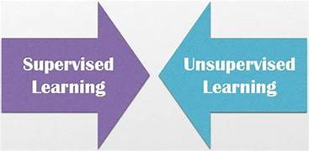
2. Classification
Purpose: Predicts discrete categories or labels.
Output: Categorical values (e.g., Yes/No, Spam/Not Spam).
Examples:
Email classification as Spam or Not Spam.
Disease diagnosis (Disease/No Disease).
Common Algorithms:
Logistic Regression
Decision Trees (for classification)
Support Vector Machines (SVM)
k-Nearest Neighbors (k-NN)
Neural Networks
Advantages of Supervised Learning:
Builds models using labeled data to produce reliable predictions for new data .
Improves accuracy over time with more training.
Versatile for various applications (e.g., spam detection, price prediction).
Supports both classification and regression tasks.
Disadvantages of Supervised Learning:
Requires well-labeled datasets, which are costly and error-prone to create.
Struggles with complex or unstructured problems.
Demands high computational power and time for training large datasets.
Applications of Supervised learning
1.Spam filtering 2. Image classification
3.Medical diagnosis 4.Fraud detection

Slide 7
Unsupervised Learning
Applications of Supervised learning
1.Spam filtering 2. Image classification
3.Medical diagnosis 4.Fraud detection
Unsupervised learning is a type of machine learning that works with data that has no labels or categories
The main goal is to find patterns and relationships in the data without any guidance.
In this approach, the machine analyzes unorganized information and groups it based on similarities, patterns, or differences. Unlike supervised learning, there is no teacher or training involved.
The machine must uncover hidden structures in the data on its own.
Advantages of Supervised Learning:
Builds models using labeled data to produce reliable predictions for new data .
Improves accuracy over time with more training.
Versatile for various applications (e.g., spam detection, price prediction).
Supports both classification and regression tasks.
Disadvantages of Supervised Learning:
Requires well-labeled datasets, which are costly and error-prone to create.
Struggles with complex or unstructured problems.
Demands high computational power and time for training large datasets.
unsupervised learning to identify the dogs and cats in a new, unseen image.

Slide 8
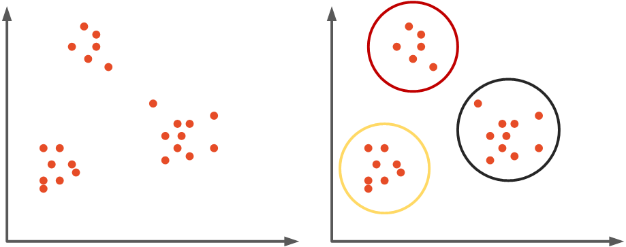
Types of Unsupervised Learning
Unsupervised Learning
Unsupervised learning is a type of machine learning that works with data that has no labels or categories
The main goal is to find patterns and relationships in the data without any guidance.
In this approach, the machine analyzes unorganized information and groups it based on similarities, patterns, or differences. Unlike supervised learning, there is no teacher or training involved.
The machine must uncover hidden structures in the data on its own.
Ex: unsupervised learning to identify the dogs and cats in a new, unseen image.
Clustering
Purpose: Groups similar data points based on their features.
How it Works: Iteratively assigns data points to clusters based on similarity.
Common Algorithms:
K-means Clustering
Hierarchical Clustering
Principal Component Analysis (PCA)
Singular Value Decomposition (SVD)
Independent Component Analysis (ICA)
Gaussian Mixture Models (GMMs)
DBSCAN (Density-Based Spatial Clustering of Applications with Noise)
Example: Grouping customers based on purchasing behavior.

Slide 9
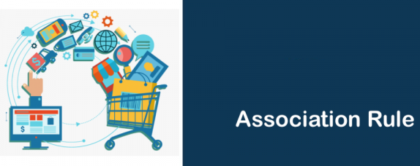
Types of Unsupervised Learning
Clustering
Purpose: Groups similar data points based on their features.
How it Works: Iteratively assigns data points to clusters based on similarity.
Common Algorithms:
K-means Clustering
Hierarchical Clustering
Principal Component Analysis (PCA)
Singular Value Decomposition (SVD)
Independent Component Analysis (ICA)
Gaussian Mixture Models (GMMs)
DBSCAN (Density-Based Spatial Clustering of Applications with Noise)
Example: Grouping customers based on purchasing behavior.
2. Association Rule Learning
Purpose: Identifies patterns or associations between items in datasets.
How it Works: Finds relationships between items frequently appearing together.
Common Algorithms:
Apriori Algorithm
Eclat Algorithm
FP-Growth Algorithm
Example: Discovering that people who buy X also tend to buy Y (Market Basket Analysis).

Slide 10

2. Association Rule Learning
Purpose: Identifies patterns or associations between items in datasets.
How it Works: Finds relationships between items frequently appearing together.
Common Algorithms:
Apriori Algorithm
Eclat Algorithm
FP-Growth Algorithm
Example: Discovering that people who buy X also tend to buy Y (Market Basket Analysis).
Applications of Unsupervised Learning:
1.Anomaly Detection
2. Scientific Discovery
3. Recommendation Systems
4.Customer Segmentation
Advantages of Unsupervised Learning:
Doesn’t require labeled data, making it faster and easier to use with large datasets.
Simplifies complex data while preserving essential patterns.
Discovers unknown patterns and relationships in data.
Reveals meaningful trends and groupings for deeper insights.
Disadvantages of Unsupervised Learning:
Lacks clear accuracy measures due to absence of labeled answers.
Can produce imprecise results for complex tasks.
Requires user intervention to label identified groups.
Sensitive to missing values, outliers, and noisy data.

Slide 11
Applications of Unsupervised Learning:
1.Anomaly Detection
2. Scientific Discovery
3. Recommendation Systems
4.Customer Segmentation
Advantages of Unsupervised Learning:
Doesn’t require labeled data, making it faster and easier to use with large datasets.
Simplifies complex data while preserving essential patterns.
Discovers unknown patterns and relationships in data.
Reveals meaningful trends and groupings for deeper insights.
Disadvantages of Unsupervised Learning:
Lacks clear accuracy measures due to absence of labeled answers.
Can produce imprecise results for complex tasks.
Requires user intervention to label identified groups.
Sensitive to missing values, outliers, and noisy data.
Thank you.

Slide 12
Thank you.

